Slide 1
CEN 3078 Computer Security
Module 3 – Defense Architectures and Design

Slide 2
Network Scanning and Vulnerability Scanning
Digital Forensics
Cybersecurity Engineering
Security policies
Firewalls
Authentication, Access controls
Federated trust
IoT/Cloud middleware
Module 3 – Defense Architectures and Design

Slide 3
Network Scanning and Vulnerability Scanning
Digital Forensics
Cybersecurity Engineering
Security policies
Firewalls
Authentication, Access controls
Federated trust
IoT/Cloud middleware
Module 3 – Defense Architectures and Design

Slide 4
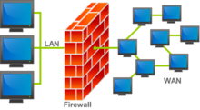
The Need For Firewalls
Internet connectivity is essential
  However it creates a threat
Effective means of protecting LANs
Inserted between the premises network and the Internet to establish a controlled link
  Can be a single computer system or a set of two or more systems working together
Used as a perimeter defense
  Single choke point to impose security and auditing
  Insulates the internal systems from external networks
Notes:
Internet connectivity is no longer optional for organizations. The information
and services available are essential to the organization. Moreover, individual users
within the organization want and need Internet access, and if this is not provided
via their LAN, they could use a wireless broadband capability from their PC to an
Internet service provider (ISP). However, while Internet access provides benefits to
the organization, it enables the outside world to reach and interact with local network
assets. This creates a threat to the organization. While it is possible to equip
each workstation and server on the premises network with strong security features,
such as intrusion protection, this may not be sufficient and in some cases is not cost effective.
Consider a network with hundreds or even thousands of systems, running
various operating systems, such as different versions of Windows, MacOS, and
Linux. When a security flaw is discovered, each potentially affected system must be
upgraded to fix that flaw. This requires scaleable configuration management and
aggressive patching to function effectively. While difficult, this is possible and is necessary
if only host-based security is used. A widely accepted alternative or at least
complement to host-based security services is the firewall. The firewall is inserted
between the premises network and the Internet to establish a controlled link and to
erect an outer security wall or perimeter. The aim of this perimeter is to protect the
premises network from Internet-based attacks and to provide a single choke point
where security and auditing can be imposed. The firewall may be a single computer
system or a set of two or more systems that cooperate to perform the firewall function.
The firewall, then, provides an additional layer of defense, insulating the internal
systems from external networks. This follows the classic military doctrine of
“defense in depth,” which is just as applicable to IT security.

Slide 5
Firewall Characteristics
Design Goals:
  All traffic from inside to outside, and vice versa, must pass through the firewall
  Only authorized traffic as defined by the local security policy will be allowed to pass
  The firewall itself is immune to penetration
    Not always true
  The firewall of a large-sized enterprise network can typically have a ruleset or ACL (Access Control List) comprising 10K+ rules
    Last-matching rules are located at the bottom of the ruleset and consume the most CPU processing power of firewalls
    If these rules get discovered by an attacker, the attacker can effectively launch a low-rate DoS attack that can bring the firewall to its knees
    Countermeasures: Random delay, periodic re-arranging of rules or caching
K. Salah, K. Sattar, A. Baig, M. Squalli, P. Calyam, “Resiliency of Popular Network Firewalls against Remote Discovery of Last-Matching Rules”, ACM Conference on Security of Information and Networks (SIN), 2009.
Notes:
[BELL94] lists the following design goals for a firewall:
1. All traffic from inside to outside, and vice versa, must pass through the firewall.
This is achieved by physically blocking all access to the local network except via
the firewall. Various configurations are possible, as explained later in this chapter.
2. Only authorized traffic, as defined by the local security policy, will be allowed
to pass. Various types of firewalls are used, which implement various types of
security policies, as explained later in this chapter.
3. The firewall itself is immune to penetration. This implies the use of a hardened
system with a secured operating system, as we will describe in Chapter 12.

Slide 6
Firewall Access Policy
A critical component in the planning and implementation of a firewall is specifying a suitable access policy
  This lists the types of traffic authorized to pass through the firewall
  Includes address ranges, protocols, applications and content types
This policy should be developed from the organization’s information security risk assessment and policy
Should be developed from a broad specification of which traffic types the organization needs to support
  Then refined to detail the filter elements which can then be implemented within an appropriate firewall topology
Notes:
A critical component in the planning and implementation of a firewall is
specifying a suitable access policy. This lists the types of traffic authorized to pass
through the firewall, including address ranges, protocols, applications and content
types. This policy should be developed from the organization’s information security
risk assessment and policy, that we discuss in Chapters 14 and 15. This policy
should be developed from a broad specification of which traffic types the organization
needs to support. It is then refined to detail the filter elements we discuss next,
which can then be implemented within an appropriate firewall topology.

Slide 7
Firewall Filter Characteristics
Characteristics that a firewall access policy could use to filter traffic include (as per NIST SP 800-41):
IP address and protocol values
This type of filtering is used by packet filter and stateful inspection firewalls
Typically used to limit access to specific services
Application protocol
This type of filtering is used by an application-level gateway that relays and monitors the exchange of information for specific application protocols
User identity
Typically for inside users who identify themselves using some form of secure authentication technology
Network activity
Controls access based on considerations such as the time or request, rate of requests, or other activity patterns
Notes:
NIST SP 800-41 (Guidelines on Firewalls and Firewall Policy, September 2009)
lists a range of characteristics that a firewall access policy could use to filter traffic,
including:
• IP Address and Protocol Values: Controls access based on the source or
destination addresses and port numbers, direction of flow being inbound or
outbound, and other network and transport layer characteristics. This type of
filtering is used by packet filter and stateful inspection firewalls. It is typically
used to limit access to specific services.
• Application Protocol: Controls access on the basis of authorized application
protocol data. This type of filtering is used by an application-level gateway
that relays and monitors the exchange of information for specific application
protocols, for example, checking Simple Mail Transfer Protocol (SMTP) e-mail for spam, or HTPP Web requests to
authorized sites only.
• User Identity: Controls access based on the users identity, typically for inside
users who identify themselves using some form of secure authentication technology,
such as IPSec (Chapter 22).
• Network Activity: Controls access based on considerations such as the time or
request, for example, only in business hours; rate of requests, for example, to detect scanning
attempts; or other activity patterns.

Slide 8
Firewall Capabilities and Limits
Capabilities:
  Defines a single choke point
  Provides a location for monitoring security events
  Convenient platform for several Internet functions that are not security related
  Can serve as the platform for IPSec
    IPSec is a standard suite of protocols between 2 communication points across the IP network that provide data authentication, integrity, and confidentiality; It also defines the encrypted, decrypted and authenticated packets
Limitations:
  Cannot protect against attacks bypassing firewall
  May not protect fully against internal threats
  Improperly secured wireless LAN can be accessed from outside the organization
  Laptop, or portable storage device may be infected outside the corporate network then used internally
Notes:
Before proceeding to the details of firewall types and configurations, it is best
to summarize what one can expect from a firewall. The following capabilities are
within the scope of a firewall:
1. A firewall defines a single choke point that attempts to keep unauthorized
users out of the protected network, prohibit potentially vulnerable services
from entering or leaving the network, and provide protection from various
kinds of IP spoofing and routing attacks. The use of a single choke point
simplifies security management because security capabilities are consolidated
on a single system or set of systems.
2. A firewall provides a location for monitoring security-related events. Audits
and alarms can be implemented on the firewall system.
3. A firewall is a convenient platform for several Internet functions that are not
security related. These include a network address translator, which maps local
addresses to Internet addresses, and a network management function that
audits or logs Internet usage.
4. A firewall can serve as the platform for IPSec. Using the tunnel mode capability
described in Chapter 22 , the firewall can be used to implement virtual
private networks.
Firewalls have their limitations, including the following:
1. The firewall cannot protect against attacks that bypass the firewall. Internal
systems may have dial-out or mobile broadband capability to connect to
an ISP. An internal LAN may support a modem pool that provides dial-in
capability for traveling employees and telecommuters.
2. The firewall may not protect fully against internal threats, such as a disgruntled
employee or an employee who unwittingly cooperates with an external
attacker.
3. An improperly secured wireless LAN may be accessed from outside the
organization. An internal firewall that separates portions of an enterprise
network cannot guard against wireless communications between local systems
on different sides of the internal firewall.
4. A laptop, PDA, or portable storage device may be used and infected outside
the corporate network and then attached and used internally.

Slide 9
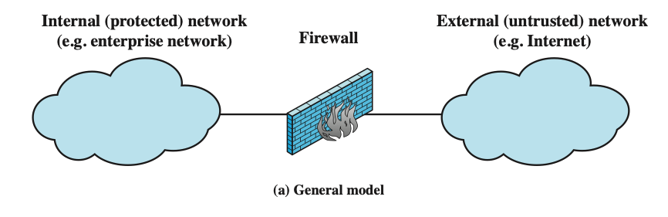
Types of Firewalls
Notes:
A firewall can monitor network traffic at a number of levels, from low-level network
packets, either individually or as part of a flow, to all traffic within a transport connection,
up to inspecting details of application protocols. The choice of which level
is appropriate is determined by the desired firewall access policy. It can operate as a
positive filter, allowing to pass only packets that meet specific criteria, or as a negative
filter, rejecting any packet that meets certain criteria. The criteria implement the
access policy for the firewall that we discussed in the previous section. Depending
on the type of firewall, it may examine one or more protocol headers in each packet,
the payload of each packet, or the pattern generated by a sequence of packets. In this
section, we look at the principal types of firewalls.

Slide 10
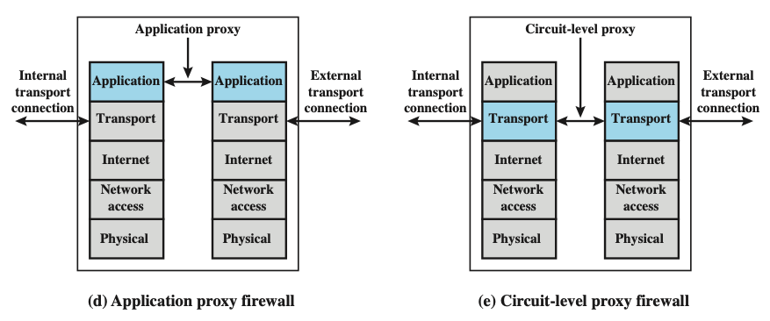
Types of Firewalls (2)
Notes:
A firewall can monitor network traffic at a number of levels, from low-level network
packets, either individually or as part of a flow, to all traffic within a transport connection,
up to inspecting details of application protocols. The choice of which level
is appropriate is determined by the desired firewall access policy. It can operate as a
positive filter, allowing to pass only packets that meet specific criteria, or as a negative
filter, rejecting any packet that meets certain criteria. The criteria implement the
access policy for the firewall that we discussed in the previous section. Depending
on the type of firewall, it may examine one or more protocol headers in each packet,
the payload of each packet, or the pattern generated by a sequence of packets. In this
section, we look at the principal types of firewalls.

Slide 11
Packet Filtering Firewall
Applies rules to each incoming and outgoing IP packet
  Typically a list of rules based on matches in the IP or TCP header
  Forwards or discards the packet based on rules match
Two default policies:
  Discard - prohibit unless expressly permitted
    More conservative, controlled, visible to users
  Forward - permit unless expressly prohibited
    Easier to manage and use but less secure
Filtering rules are based on information contained in a network packet
Source IP address
Destination IP address
Source and destination transport-level address
IP protocol field
Interface
Notes:
A packet filtering firewall applies a set of rules to each incoming and outgoing
IP packet and then forwards or discards the packet ( Figure 9.1b ). The firewall
is typically configured to filter packets going in both directions (from and to
the internal network). Filtering rules are based on information contained in a
network packet:
• Source IP address: The IP address of the system that originated the IP packet
(e.g., 192.178.1.1)
• Destination IP address: The IP address of the system the IP packet is trying to
reach (e.g., 192.168.1.2)
• Source and destination transport-level address: The transport-level (e.g., TCP
or UDP) port number, which defines applications such as SNMP or HTTP.
• IP protocol field: Defines the transport protocol
• Interface: For a firewall with three or more ports, which interface of the firewall
the packet came from or for which interface of the firewall the packet is destined.
The packet filter is typically set up as a list of rules based on matches to fields
in the IP or TCP header. If there is a match to one of the rules, that rule is invoked
to determine whether to forward or discard the packet. If there is no match to any
rule, then a default action is taken. Two default policies are possible:
• Default = discard: That which is not expressly permitted is prohibited.
• Default = forward: That which is not expressly prohibited is permitted.
The default discard policy is more conservative. Initially, everything is blocked,
and services must be added on a case-by-case basis. This policy is more visible to
users, who are more likely to see the firewall as a hindrance. However, this is the
policy likely to be preferred by businesses and government organizations. Further,
visibility to users diminishes as rules are created. The default forward policy increases
ease of use for end users but provides reduced security; the security administrator
must, in essence, react to each new security threat as it becomes known. This policy
may be used by generally more open organizations, such as universities.

Slide 12
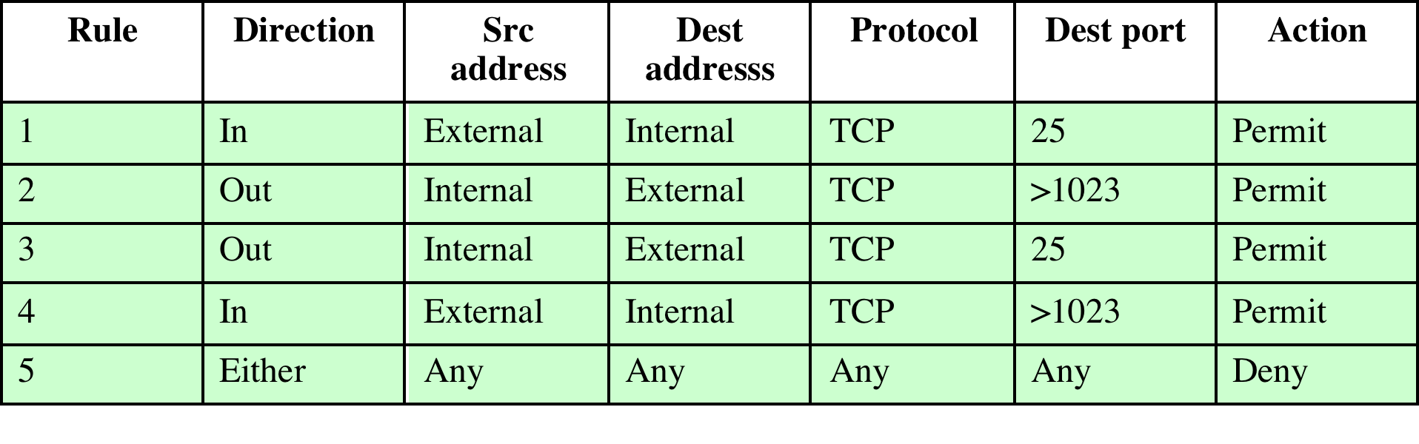
Packet Filtering Examples
Do you see problems with this rule set?
Rule 4 allows external traffic to any destination port above 1023. As an example of an exploit of this rule, an
external attacker can open a connection from the attacker’s port 5150 to an internal Web proxy server on port 8080. This is supposed to be forbidden and could allow an attack on the server.
To counter this attack, the firewall rule set can be configured with a source port field for each row. For rules 2 and 4, the source port is set to 25; for rules 1 and 3, the source port is set to >1023.
Notes:
Table 9.1 is a simplified example of a rule set for SMTP traffic. The goal is to
allow inbound and outbound email traffic but to block all other traffic. The rules are
applied top to bottom to each packet. The intent of each rule is:
1. Inbound mail from an external source is allowed (port 25 is for SMTP incoming).
2. This rule is intended to allow a response to an inbound SMTP connection.
3. Outbound mail to an external source is allowed.
4. This rule is intended to allow a response to an inbound SMTP connection.
5. This is an explicit statement of the default policy. All rule sets include this rule
implicitly as the last rule.
There are several problems with this rule set. Rule 4 allows external traffic
to any destination port above 1023. As an example of an exploit of this rule, an
external attacker can open a connection from the attacker’s port 5150 to an internal
Web proxy server on port 8080. This is supposed to be forbidden and could allow an
attack on the server. To counter this attack, the firewall rule set can be configured
with a source port field for each row. For rules 2 and 4, the source port is set to 25;
for rules 1 and 3, the source port is set to >1023.
But a vulnerability remains. Rules 3 and 4 are intended to specify that any
inside host can send mail to the outside. A TCP packet with a destination port of
25 is routed to the SMTP server on the destination machine. The problem with this
rule is that the use of port 25 for SMTP receipt is only a default; an outside machine
could be configured to have some other application linked to port 25. As the revised
rule 4 is written, an attacker could gain access to internal machines by sending packets
with a TCP source port number of 25. To counter this threat, we can add an
ACK flag field to each row. For rule 4, the field would indicate that the ACK flag
must be set on the incoming packet. Rule 4 would now look like this:
Rule 4
Direction In
Src address External
Src port 25
Dest address Internal
Protocol TCP
Dest port >1023
Flag ACK
Action. Permit
The rule takes advantage of a feature of TCP connections. Once a connection
is set up, the ACK flag of a TCP segment is set to acknowledge segments sent from
the other side. Thus, this rule allows incoming packets with a source port number of
25 that include the ACK flag in the TCP segment.

Slide 13
Packet Filtering Advantages and Weaknesses
Advantages:
  Simplicity
  Typically transparent to users and are very fast
Weaknesses:
  Cannot prevent attacks that employ application specific vulnerabilities or functions
  Limited logging functionality
  Do not support advanced user authentication
  Vulnerable to attacks on TCP/IP protocol bugs
  Improper configuration can lead to breaches
Notes:
One advantage of a packet filtering firewall is its simplicity. Also, packet filters
typically are transparent to users and are very fast. NIST SP 800-41 lists the following
weaknesses of packet filter firewalls:
• Because packet filter firewalls do not examine upper-layer data, they cannot
prevent attacks that employ application-specific vulnerabilities or functions.
For example, a packet filter firewall cannot block specific application
commands; if a packet filter firewall allows a given application, all functions
available within that application will be permitted.
• Because of the limited information available to the firewall, the logging
functionality present in packet filter firewalls is limited. Packet filter logs
normally contain the same information used to make access control decisions
(source address, destination address, and traffic type).
• Most packet filter firewalls do not support advanced user authentication
schemes. Once again, this limitation is mostly due to the lack of upper-layer
functionality by the firewall.
• Packet filter firewalls are generally vulnerable to attacks and exploits that take
advantage of problems within the TCP/IP specification and protocol stack,
such as network layer address spoofing . Many packet filter firewalls cannot
detect a network packet in which the OSI Layer 3 addressing information has
been altered. Spoofing attacks are generally employed by intruders to bypass
the security controls implemented in a firewall platform.
• Finally, due to the small number of variables used in access control decisions,
packet filter firewalls are susceptible to security breaches caused by improper
configurations. In other words, it is easy to accidentally configure a packet
filter firewall to allow traffic types, sources, and destinations that should be
denied based on an organization’s information security policy.
Some of the attacks that can be made on packet filtering firewalls and the
appropriate countermeasures are the following:
• IP address spoofing : The intruder transmits packets from the outside with a
source IP address field containing an address of an internal host. The attacker
hopes that the use of a spoofed address will allow penetration of systems that
employ simple source address security, in which packets from specific trusted
internal hosts are accepted. The countermeasure is to discard packets with an
inside source address if the packet arrives on an external interface. In fact, this
countermeasure is often implemented at the router external to the firewall.
• Source routing attacks: The source station specifies the route that a packet
should take as it crosses the Internet, in the hopes that this will bypass security
measures that do not analyze the source routing information. A countermeasure
is to discard all packets that use this option.
• Tiny fragment attacks: The intruder uses the IP fragmentation option to create
extremely small fragments and force the TCP header information into
a separate packet fragment. This attack is designed to circumvent filtering
rules that depend on TCP header information. Typically, a packet filter
will make a filtering decision on the first fragment of a packet. All subsequent
fragments of that packet are filtered out solely on the basis that
they are part of the packet whose first fragment was rejected. The attacker
hopes that the filtering firewall examines only the first fragment and that
the remaining fragments are passed through. A tiny fragment attack can be
defeated by enforcing a rule that the first fragment of a packet must contain
a predefined minimum amount of the transport header. If the first fragment
is rejected, the filter can remember the packet and discard all subsequent
fragments.

Slide 14
Types of Firewalls
Notes:
A firewall can monitor network traffic at a number of levels, from low-level network
packets, either individually or as part of a flow, to all traffic within a transport connection,
up to inspecting details of application protocols. The choice of which level
is appropriate is determined by the desired firewall access policy. It can operate as a
positive filter, allowing to pass only packets that meet specific criteria, or as a negative
filter, rejecting any packet that meets certain criteria. The criteria implement the
access policy for the firewall that we discussed in the previous section. Depending
on the type of firewall, it may examine one or more protocol headers in each packet,
the payload of each packet, or the pattern generated by a sequence of packets. In this
section, we look at the principal types of firewalls.

Slide 15
Stateful Inspection Firewall
Tightens rules for TCP traffic by creating a directory of outbound TCP connections
There is an entry for each currently established connection
Packet filter allows incoming traffic to high numbered ports only for those packets that fit the profile of one of the entries in this directory
Reviews packet information but also records information about TCP connections
Keeps track of TCP sequence numbers to prevent attacks that depend on the sequence number
Inspects data for protocols, especially critical commands
Notes:
A traditional packet filter makes filtering decisions on an individual packet basis
and does not take into consideration any higher-layer context. To understand what
is meant by context and why a traditional packet filter is limited with regard to context,
a little background is needed. Most standardized applications that run on top
of TCP follow a client/server model. For example, for the Simple Mail Transfer
Protocol (SMTP), e-mail is transmitted from a client system to a server system.
The client system generates new e-mail messages, typically from user input. The
server system accepts incoming e-mail messages and places them in the appropriate
user mailboxes. SMTP operates by setting up a TCP connection between client
and server, in which the TCP server port number, which identifies the SMTP server
application, is 25. The TCP port number for the SMTP client is a number between
1024 and 65535 that is generated by the SMTP client.
In general, when an application that uses TCP creates a session with a remote
host, it creates a TCP connection in which the TCP port number for the remote
(server) application is a number less than 1024 and the TCP port number for the
local (client) application is a number between 1024 and 65535. The numbers less
than 1024 are the “well-known” port numbers and are assigned permanently to
particular applications (e.g., 25 for server SMTP). The numbers between 1024 and
65535 are generated dynamically and have temporary significance only for the
lifetime of a TCP connection.
A simple packet filtering firewall must permit inbound network traffic on all
these high-numbered ports for TCP-based traffic to occur. This creates a vulnerability
that can be exploited by unauthorized users.

Slide 16
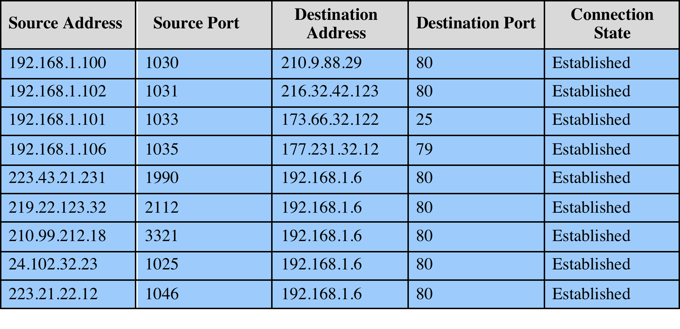
Example Stateful Firewall Connection State
Notes:
A stateful inspection packet firewall tightens up the rules for TCP traffic by
creating a directory of outbound TCP connections, as shown in Table 9.2 . There is
an entry for each currently established connection. The packet filter will now allow
incoming traffic to high-numbered ports only for those packets that fit the profile of
one of the entries in this directory.
A stateful packet inspection firewall reviews the same packet information
as a packet filtering firewall, but also records information about TCP connections
(Figure 9.1c). Some stateful firewalls also keep track of TCP sequence numbers
to prevent attacks that depend on the sequence number, such as session hijacking.
Some even inspect limited amounts of application data for some well-known
protocols like FTP, IM, and SIPS commands, in order to identify and track related
connections.

Slide 17
Types of Firewalls (2)
Notes:
A firewall can monitor network traffic at a number of levels, from low-level network
packets, either individually or as part of a flow, to all traffic within a transport connection,
up to inspecting details of application protocols. The choice of which level
is appropriate is determined by the desired firewall access policy. It can operate as a
positive filter, allowing to pass only packets that meet specific criteria, or as a negative
filter, rejecting any packet that meets certain criteria. The criteria implement the
access policy for the firewall that we discussed in the previous section. Depending
on the type of firewall, it may examine one or more protocol headers in each packet,
the payload of each packet, or the pattern generated by a sequence of packets. In this
section, we look at the principal types of firewalls.

Slide 18
Application-Level Gateway
Also called an application proxy
Acts as a relay of application-level traffic
  User contacts gateway using a TCP/IP application
  User is authenticated
  Gateway contacts application on remote host and relays TCP segments between server and user
Must have proxy code for each application
  May restrict application features supported
Tend to be more secure than packet filters
Disadvantage is the additional processing overhead on each connection
Notes:
An application-level gateway, also called an application proxy , acts as a relay of
application-level traffic ( Figure 9.1d ). The user contacts the gateway using a TCP/
IP application, such as Telnet or FTP, and the gateway asks the user for the name
of the remote host to be accessed. When the user responds and provides a valid
user ID and authentication information, the gateway contacts the application on
the remote host and relays TCP segments containing the application data between
the two endpoints. If the gateway does not implement the proxy code for a specific
application, the service is not supported and cannot be forwarded across the firewall.
Further, the gateway can be configured to support only specific features of an
application that the network administrator considers acceptable while denying all
other features.
Application-level gateways tend to be more secure than packet filters. Rather
than trying to deal with the numerous possible combinations that are to be allowed
and forbidden at the TCP and IP level, the application-level gateway need only
scrutinize a few allowable applications. In addition, it is easy to log and audit all
incoming traffic at the application level.
A prime disadvantage of this type of gateway is the additional processing
overhead on each connection. In effect, there are two spliced connections between
the end users, with the gateway at the splice point, and the gateway must examine
and forward all traffic in both directions.

Slide 19
Circuit-Level Gateway
Circuit-level proxy
  Sets up two TCP connections, one between itself and a TCP user on an inner host and one on an outside host
  Relays TCP segments from one connection to the other without examining contents
  Security function consists of determining which connections will be allowed
Typically used when inside users are trusted
  May use application-level gateway inbound and circuit-level gateway outbound
  Lower overheads
Notes:
A fourth type of firewall is the circuit-level gateway or circuit-level proxy ( Figure 9.1e ).
This can be a stand-alone system or it can be a specialized function performed by an
application-level gateway for certain applications. As with an application gateway,
a circuit-level gateway does not permit an end-to-end TCP connection; rather,
the gateway sets up two TCP connections, one between itself and a TCP user on
an inner host and one between itself and a TCP user on an outside host. Once the
two connections are established, the gateway typically relays TCP segments from
one connection to the other without examining the contents. The security function
consists of determining which connections will be allowed.
A typical use of circuit-level gateways is a situation in which the system
administrator trusts the internal users. The gateway can be configured to support
application-level or proxy service on inbound connections and circuit-level functions
for outbound connections. In this configuration, the gateway can incur the processing
overhead of examining incoming application data for forbidden functions but
does not incur that overhead on outgoing data.

Slide 20
Network Scanning and Vulnerability Scanning
Digital Forensics
Cybersecurity Engineering
Security policies
Firewalls
Authentication, Access controls
Federated trust
IoT/Cloud middleware
Module 3 – Defense Architectures and Design

Slide 21
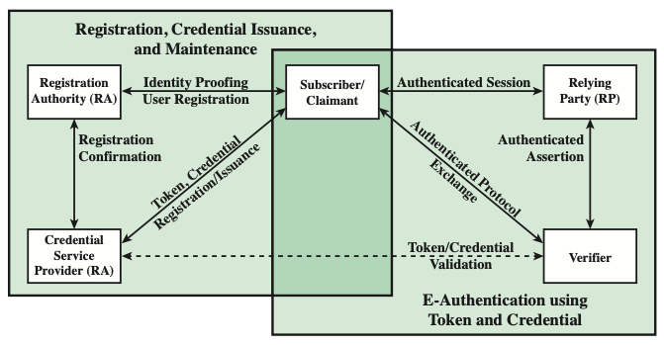
Authentication
The process of establishing confidence in user identities that are presented electronically to an information system
Notes:
NIST SP 800-63-3 (Digital Authentication Guideline , October 2016) defines digital
user authentication as the process of establishing confidence in user identities
that are presented electronically to an information system. Systems can use the
authenticated identity to determine if the authenticated individual is authorized
to perform particular functions, such as database transactions or access to system
resources. In many cases, the authentication and transaction, or other authorized
function, take place across an open network such as the Internet. Equally authentication
and subsequent authorization can take place locally, such as across a local
area network.

Slide 22
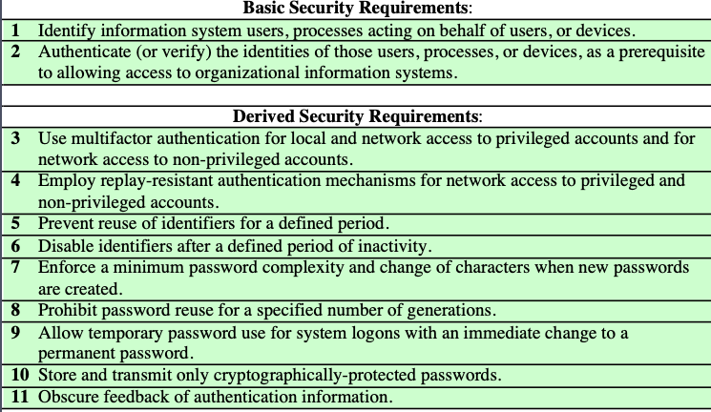
Identification and Authentication Security Requirements
Notes:
NIST SP 800-63-3 (Digital Authentication Guideline , October 2016) defines digital
user authentication as the process of establishing confidence in user identities
that are presented electronically to an information system. Systems can use the
authenticated identity to determine if the authenticated individual is authorized
to perform particular functions, such as database transactions or access to system
resources. In many cases, the authentication and transaction, or other authorized
function, take place across an open network such as the Internet. Equally authentication
and subsequent authorization can take place locally, such as across a local
area network.

Slide 23
Authenticating User Identity - Basis
Something the individual knows
  Password, PIN, answers to prearranged questions
Something the individual possesses (token)
  Smartphone, electronic keycard, physical key
Something the individual is (static biometrics)
  Fingerprint, retina, face
Something the individual does (dynamic biometrics)
  Voice pattern, handwriting, typing rhythm
Notes:
There are four general means of authenticating a user's identity, which can be used alone or in combination:
• Something the individual knows: Examples includes a password, a personal identification number (PIN), or answers to a prearranged set of questions.
• Something the individual possesses: Examples include electronic keycards, smart cards, and physical keys. This type of authenticator is referred to as a token.
• Something the individual is (static biometrics): Examples include recognition by fingerprint, retina, and face.
• Something the individual does (dynamic biometrics): Examples include recognition by voice pattern, handwriting characteristics, and typing rhythm.
All of these methods, properly implemented and used, can provide secure user authentication. However, each method has problems. An adversary may be able to guess or steal a password. Similarly, an adversary may be able to forge or steal a token. A user may forget a password or lose a token. Further, there is a significant administrative overhead for managing password and token information on systems and securing such information on systems. With respect to biometric authenticators, there are a variety of problems, including dealing with false positives and false negatives, user acceptance, cost, and convenience.

Slide 24
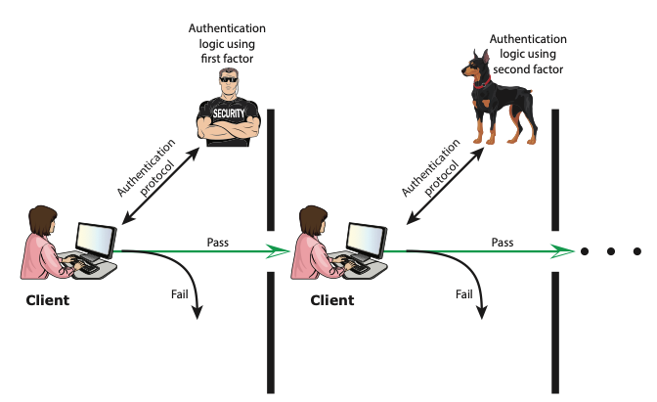
Multi-factor Authentication
Multifactor authentication refers to the use of more than one of the authentication means
Notes:
Multifactor authentication refers to the use
of more than one of the authentication means in the preceding list (see Figure 3.2).
The strength of authentication systems is largely determined by the number of factors
incorporated by the system. Implementations that use two factors are considered to
be stronger than those that use only one factor; systems that incorporate three factors
are stronger than systems that only incorporate two of the factors, and so on.

Slide 25
Risk Assessment for User Authentication
Assurance Level
Potential impact
Areas of risk

Slide 26
Assurance Level
Describes an organization’s degree of certainty that a user has presented a credential that refers to his or her identity
More specifically is defined as:
The degree of confidence in the vetting process used to establish the identity of the individual to whom the credential was issued
The degree of confidence that the individual who uses the credential is the individual to whom the credential was issued
Four levels of assurance
Level 1
Little or no confidence in the asserted identity's validity
Level 2
Some confidence in the asserted identity’s validity
Level 3
High confidence in the asserted identity's validity
Level 4
Very high confidence in the asserted identity’s validity
Notes:
An assurance level describes an organization’s degree of
certainty that a user has presented a credential that refers to his or her identity.
More specifically, assurance is defined as (1) the degree of confidence in the vetting
process used to establish the identity of the individual to whom the credential was
issued and (2) the degree of confidence that the individual who uses the credential is
the individual to whom the credential was issued. SP 800-63-3 recognizes four levels
of assurance:
• Level 1: Little or no confidence in the asserted identity’s validity. An example
of where this level is appropriate is a consumer registering to participate in
a discussion at a company web site discussion board. Typical authentication
technique at this level would be a user-supplied ID and password at the time
of the transaction.
• Level 2: Some confidence in the asserted identity’s validity. Level 2 credentials
are appropriate for a wide range of business with the public where organizations
require an initial identity assertion (the details of which are verified
independently prior to any action). At this level, some sort of secure authentication
protocol needs to be used, together with one of the means of authentication
summarized previously and discussed in subsequent sections.
• Level 3: High confidence in the asserted identity’s validity. This level is appropriate
to enable clients or employees to access restricted services of high value
but not the highest value. An example for which this level is appropriate:
A patent attorney electronically submits confidential patent information to
the U.S. Patent and Trademark Office. Improper disclosure would give competitors
a competitive advantage. Techniques that would need to be used at
this level require more than one factor of authentication; that is, at least two
independent authentication techniques must be used.
• Level 4: Very high confidence in the asserted identity’s validity. This level is
appropriate to enable clients or employees to access restricted services of very
high value or for which improper access is very harmful. For example, a law
enforcement official accesses a law enforcement database containing criminal
records. Unauthorized access could raise privacy issues and/or compromise
investigations. Typically, level 4 authentication requires the use of multiple
factors as well as in-person registration.

Slide 27
Potential Impact
FIPS 199 defines three levels of potential impact on organizations or individuals should there be a breach of security:
  Low
    An authentication error could be expected to have a limited adverse effect on organizational operations, organizational assets, or individuals
  Moderate
    An authentication error could be expected to have a serious adverse effect
  High
    An authentication error could be expected to have a severe or catastrophic adverse effect
Notes:
A concept closely related to that of assurance level is potential
impact. FIPS 199 (Standards for Security Categorization of Federal Information and
Information Systems, 2004) defines three levels of potential impact on organizations
or individuals should there be a breach of security (in our context, a failure in user
authentication):
• Low: An authentication error could be expected to have a limited adverse
effect on organizational operations, organizational assets, or individuals. More
specifically, we can say that the error might: (1) cause a degradation in mission
capability to an extent and duration that the organization is able to perform its
primary functions, but the effectiveness of the functions is noticeably reduced;
(2) result in minor damage to organizational assets; (3) result in minor financial
loss to the organization or individuals; or (4) result in minor harm to individuals.
• Moderate: An authentication error could be expected to have a serious
adverse effect. More specifically, the error might: (1) cause a significant degradation
in mission capability to an extent and duration that the organization is
able to perform its primary functions, but the effectiveness of the functions is
significantly reduced; (2) result in significant damage to organizational assets;
(3) result in significant financial loss; or (4) result in significant harm to individuals
that does not involve loss of life or serious life threatening injuries.
• High: An authentication error could be expected to have a severe or catastrophic
adverse effect. The error might: (1) cause a severe degradation in or
loss of mission capability to an extent and duration that the organization is not
able to perform one or more of its primary functions; (2) result in major damage
to organizational assets; (3) result in major financial loss to the organization
or individuals; or (4) result in severe or catastrophic harm to individuals
involving loss of life or serious life threatening injuries.

Slide 28
Maximum Potential Impacts for Each Assurance Level
Notes:
The mapping between the potential impact and the appropriate
level of assurance that is satisfactory to deal with the potential impact depends on the
context. Table 3.2 shows a possible mapping for various risks that an organization
may be exposed to. This table suggests a technique for doing risk assessment. For
a given information system or service asset of an organization, the organization
needs to determine the level of impact if an authentication failure occurs, using the
categories of impact, or risk areas, that are of concern.
For example, consider the potential for financial loss if there is an authentication
error that results in unauthorized access to a database. Depending on the
nature of the database, the impact could be:
• Low: At worst, an insignificant or inconsequential unrecoverable financial
loss to any party, or at worst, an insignificant or inconsequential organization
liability.
• Moderate: At worst, a serious unrecoverable financial loss to any party, or a
serious organization liability.
• High: severe or catastrophic unrecoverable financial loss to any party; or severe
or catastrophic organization liability.
The table indicates that if the potential impact is low, an assurance level of 1
is adequate. If the potential impact is moderate, an assurance level of 2 or 3 should
be achieved. And if the potential impact is high, an assurance level of 4 should be
implemented. Similar analysis can be performed for the other categories shown in
the table. The analyst can then pick an assurance level such that it meets or exceeds
the requirements for assurance in each of the categories listed in the table. So, for
example, for a given system, if any of the impact categories has a potential impact of
high, or if the personal safety category has a potential impact of moderate or high,
then level 4 assurance should be implemented.

Slide 29
Password Cracking
Dictionary attacks
Develop a large dictionary of possible passwords and try each against the password file
Each password must be hashed using each salt value and then compared to stored hash values
Rainbow table attacks
Pre-compute tables of hash values for all salts
A mammoth table of hash values
Can be countered by using a sufficiently large salt value and a sufficiently large hash length
Password crackers exploit the fact that people choose easily guessable passwords
Shorter password lengths are also easier to crack
John the Ripper
Open-source password cracker first developed in in 1996
Uses a combination of brute-force and dictionary techniques
Notes:
The traditional approach to password guessing,
or password cracking as it is called, is to develop a large dictionary of possible
passwords and to try each of these against the password file. This means that
each password must be hashed using each salt value in the password file and then
compared to stored hash values. If no match is found, then the cracking program
tries variations on all the words in its dictionary of likely passwords. Such variations
include backward spelling of words, additional numbers or special characters, or
sequence of characters,
An alternative is to trade off space for time by precomputing potential hash
values. In this approach the attacker generates a large dictionary of possible passwords.
For each password, the attacker generates the hash values associated with
each possible salt value. The result is a mammoth table of hash values known as a
rainbow table. For example, [OECH03] showed that using 1.4 GB of data, he could
crack 99.9% of all alphanumeric Windows password hashes in 13.8 seconds. This
approach can be countered by using a sufficiently large salt value and a sufficiently
large hash length. Both the FreeBSD and OpenBSD approaches should be secure
from this attack for the foreseeable future.
To counter the use of large salt values and hash lengths, password crackers
exploit the fact that some people choose easily guessable passwords. A particular
problem is that users, when permitted to choose their own password, tend to choose
short ones. [BONN12] summarizes the results of a number of studies over the past
few years involving over 40 million hacked passwords, as well as their own analysis
of almost 70 million anonymized passwords of Yahoo! users, and found a tendency
toward six to eight characters of length and a strong dislike of non-alphanumeric
characters in passwords.
The analysis of the 70 million passwords in [BONN12] estimates that passwords
provide fewer than 10 bits of security against an online, trawling attack,
and only about 20 bits of security against an optimal offline dictionary attack. In
other words, an attacker who can manage 10 guesses per account, typically within
the realm of rate-limiting mechanisms, will compromise around 1% of accounts,
just as they would against random 10-bit strings. Against an optimal attacker
performing unrestricted brute force and wanting to break half of all available
accounts, passwords appear to be roughly equivalent to 20-bit random strings.
It can be seen then that using offline search enables an adversary to break
a large number of accounts, even if a significant amount of iterated hashing is
Used.
Password length is only part of the problem. Many people, when permitted
to choose their own password, pick a password that is guessable, such as their
own name, their street name, a common dictionary word, and so forth. This makes
the job of password cracking straightforward. The cracker simply has to test the
password file against lists of likely passwords. Because many people use guessable
passwords, such a strategy should succeed on virtually all systems.
Attacks that use a combination of brute-force and dictionary techniques have
become common. A notable example of this dual approach is John the Ripper, an
open-source password cracker first developed in 1996 and still in use [OPEN13].

Slide 30
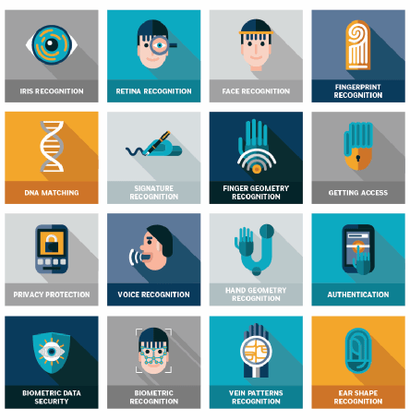
Biometric Authentication
Attempts to authenticate an individual based on unique physical characteristics
Based on pattern recognition
Is technically complex and expensive when compared to passwords and tokens
Physical characteristics used include:
  Facial characteristics
  Fingerprints
  Hand geometry
  Retinal pattern
  Iris
  Signature
  Voice
Notes:
A biometric authentication system attempts to authenticate an individual based on
his or her unique physical characteristics. These include static characteristics, such
as fingerprints, hand geometry, facial characteristics, and retinal and iris patterns;
and dynamic characteristics, such as voiceprint and signature. In essence, biometrics
is based on pattern recognition. Compared to passwords and tokens, biometric
authentication is both technically complex and expensive. While it is used in a
number of specific applications, biometrics has yet to mature as a standard tool for
user authentication to computer systems.
A number of different types of physical characteristics are either in use or under
study for user authentication. The most common are the following:
• Facial characteristics: Facial characteristics are the most common means
of human-to-human identification; thus it is natural to consider them for
identification by computer. The most common approach is to define characteristics
based on relative location and shape of key facial features, such as
eyes, eyebrows, nose, lips, and chin shape. An alternative approach is to use an
infrared camera to produce a face thermogram that correlates with the underlying
vascular system in the human face.
• Fingerprints: Fingerprints have been used as a means of identification for
centuries, and the process has been systematized and automated particularly
for law enforcement purposes. A fingerprint is the pattern of ridges and
furrows on the surface of the fingertip. Fingerprints are believed to be unique
across the entire human population. In practice, automated fingerprint recognition
and matching system extract a number of features from the fingerprint
for storage as a numerical surrogate for the full fingerprint pattern.
• Hand geometry: Hand geometry systems identify features of the hand,
including shape, and lengths and widths of fingers.
• Retinal pattern: The pattern formed by veins beneath the retinal surface is
unique and therefore suitable for identification. A retinal biometric system
obtains a digital image of the retinal pattern by projecting a low-intensity
beam of visual or infrared light into the eye.
• Iris: Another unique physical characteristic is the detailed structure of the iris.
• Signature: Each individual has a unique style of handwriting and this is
reflected especially in the signature, which is typically a frequently written
sequence. However, multiple signature samples from a single individual will
not be identical. This complicates the task of developing a computer representation
of the signature that can be matched to future samples.
• Voice: Whereas the signature style of an individual reflects not only the unique
physical attributes of the writer but also the writing habit that has developed,
voice patterns are more closely tied to the physical and anatomical characteristics
of the speaker. Nevertheless, there is still a variation from sample to sample over
time from the same speaker, complicating the biometric recognition task.

Slide 31
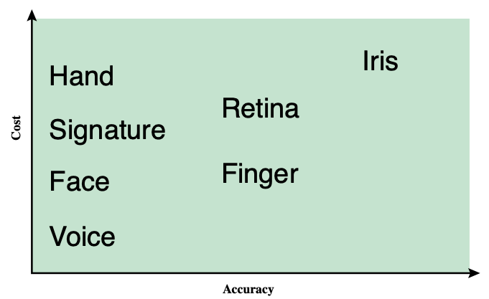
Biometric Authentication – Cost vs. Accuracy
Notes:
Figure 3.8 gives a rough indication of the relative cost and accuracy of these
biometric measures. The concept of accuracy does not apply to user authentication
schemes using smart cards or passwords. For example, if a user enters a password,
it either matches exactly the password expected for that user or not. In the case of
biometric parameters, the system instead must determine how closely a presented
biometric characteristic matches a stored characteristic. Before elaborating on the
concept of biometric accuracy, we need to have a general idea of how biometric
systems work.

Slide 32
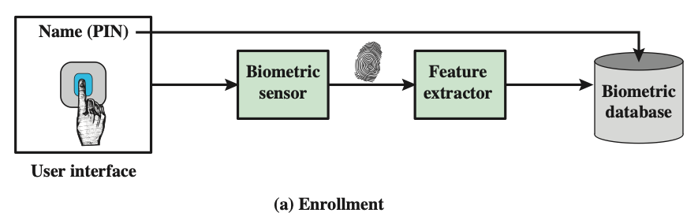
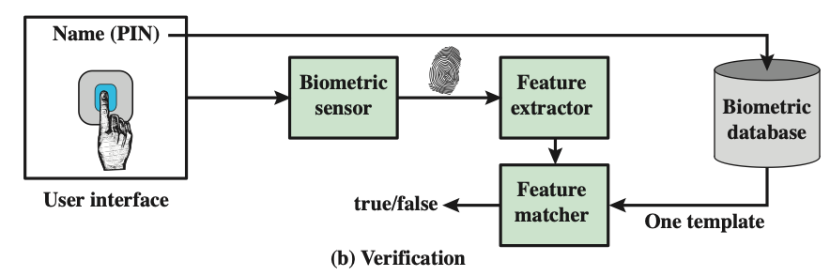
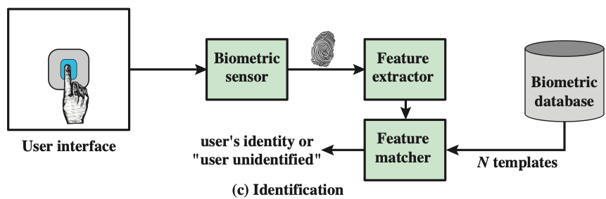
Biometric Authentication – Process
Notes:
Figure 3.9 illustrates the operation of a biometric system. Each individual who is to be
included in the database of authorized users must first be enrolled in the system. This
is analogous to assigning a password to a user. For a biometric system, the user presents
a name and, typically, some type of password or PIN to the system. At the same
time the system senses some biometric characteristic of this user (e.g., fingerprint of
right index finger). The system digitizes the input and then extracts a set of features
that can be stored as a number or set of numbers representing this unique biometric
characteristic; this set of numbers is referred to as the user’s template. The user is now
enrolled in the system, which maintains for the user a name (ID), perhaps a PIN or
password, and the biometric value.
Depending on application, user authentication on a biometric system involves
either verification or identification. Verification is analogous to a user logging on
to a system by using a memory card or smart card coupled with a password or PIN.
For biometric verification, the user enters a PIN and also uses a biometric sensor.
The system extracts the corresponding feature and compares that to the template
stored for this user. If there is a match, then the system authenticates this user.
For an identification system, the individual uses the biometric sensor but
presents no additional information. The system then compares the presented
template with the set of stored templates. If there is a match, then this user is
identified. Otherwise, the user is rejected.

Slide 33
Authentication Security Issues
Authentication Security Issues
Eavesdropping
Adversary attempts to learn the password by some sort of attack that involves the physical proximity of user and adversary
Host Attacks
Directed at the user file at the host where passwords, token passcodes, or biometric templates are stored
Replay
Adversary repeats a previously captured user response
Client Attacks
Adversary attempts to achieve user authentication without access to the remote host or the intervening communications path
Trojan Horse An application or physical device masquerades as an authentic application or device for the purpose of capturing a user password, passcode, or biometric
Denial-of-Service
Attempts to disable a user authentication service by flooding the service with numerous authentication attempts
Notes:
Client attacks are those in which an adversary attempts to achieve user
authentication without access to the remote host or to the intervening communications
path. The adversary attempts to masquerade as a legitimate user. For a password-
based system, the adversary may attempt to guess the likely user password.
Multiple guesses may be made. At the extreme, the adversary sequences through
all possible passwords in an exhaustive attempt to succeed. One way to thwart such
an attack is to select a password that is both lengthy and unpredictable. In effect,
such a password has large entropy; that is, many bits are required to represent the
password. Another countermeasure is to limit the number of attempts that can be
made in a given time period from a given source.
A token can generate a high-entropy passcode from a low-entropy PIN or password,
thwarting exhaustive searches. The adversary may be able to guess or acquire
the PIN or password but must additionally acquire the physical token to succeed.
Host attacks are directed at the user file at the host where passwords, token
passcodes, or biometric templates are stored. Section 3.2 discusses the security
considerations with respect to passwords. For tokens, there is the additional
defense of using one-time passcodes, so that passcodes are not stored in a host
passcode file. Biometric features of a user are difficult to secure because they are
physical features of the user. For a static feature, biometric device authentication
adds a measure of protection. For a dynamic feature, a challenge-response
protocol enhances security.
Eavesdropping in the context of passwords refers to an adversary’s attempt to
learn the password by observing the user, finding a written copy of the password,
or some similar attack that involves the physical proximity of user and adversary.
Another form of eavesdropping is keystroke logging (keylogging), in which malicious
hardware or software is installed so that the attacker can capture the user’s keystrokes
for later analysis. A system that relies on multiple factors (e.g., password plus token or
password plus biometric) is resistant to this type of attack. For a token, an analogous
threat is theft of the token or physical copying of the token. Again, a multifactor
protocol resists this type of attack better than a pure token protocol. The analogous
threat for a biometric protocol is copying or imitating the biometric
parameter so as to generate the desired template. Dynamic biometrics are less susceptible
to such attacks. For static biometrics, device authentication is a useful countermeasure.
Replay attacks involve an adversary repeating a previously captured
user response. The most common countermeasure to such attacks is the challenge-response
protocol.
In a Trojan horse attack, an application or physical device masquerades as
an authentic application or device for the purpose of capturing a user password,
passcode, or biometric. The adversary can then use the captured information to
masquerade as a legitimate user. A simple example of this is a rogue bank machine
used to capture user ID/password combinations.
A denial-of-service attack attempts to disable a user authentication service by
flooding the service with numerous authentication attempts. A more selective attack
denies service to a specific user by attempting logon until the threshold is reached
that causes lockout to this user because of too many logon attempts. A multifactor
authentication protocol that includes a token thwarts this attack, because the
adversary must first acquire the token.

Slide 34
Potential Attacks, Susceptible Authenticators, and Typical Defenses
en·tro·py: lack of order or predictability; gradual decline into disorder
Notes:
As with any security service, user authentication, particularly remote user authentication,
is subject to a variety of attacks. Table 3.5, from [OGOR03], summarizes
the principal attacks on user authentication, broken down by type of authenticator.
Much of the table is self-explanatory. In this section, we expand on some of the
table’s entries.

Slide 35
Potential Attacks, Susceptible Authenticators, and Typical Defenses
Notes:
As with any security service, user authentication, particularly remote user authentication,
is subject to a variety of attacks. Table 3.5, from [OGOR03], summarizes
the principal attacks on user authentication, broken down by type of authenticator.
Much of the table is self-explanatory. In this section, we expand on some of the
table’s entries.

